Slide 1
Call Plan Generation through SalesIQ - Introduction
Problem Statement
Legacy Call Planning is done through backend process where rules are processed in backend and analytics are created by Axtria CPG Team and presented in PPT’s.
This presents challenge in terms of effort and Time
Solution
Introducing CPG through SalesIQ, a well integrated systems that connects with InsightsMAx and provide control to HO users to make changes, analyses results, run Simulations and Compare Scenarios.
One click Push for Field Collaboration

Slide 2
Using a platform approach for call planning brings several advantages
Enhanced Productivity
Prebuilt Libraries: Comes with preconfigured environments
Visualization and Monitoring: Integrated dashboards for tracking workflows
Low-Code/No-Code Options: Simplify repetitive tasks or build pipelines quickly
Streamlined Parameterization
Dynamic Adjustments: Allows parameterization of code, reusable workflows
Automated Testing: Parameterization facilitates A/B testing and experimentation
Robust Versioning and Traceability
Code and Data Versioning: Version control beyond code to include datasets
Rollback Capability: Easy revert to previous versions
Experiment Tracking: Logs of experiments, configurations, and
Improved Collaboration
Version Control: Includes built-in version control (e.g., Git integration)
Shared Workspaces: Teams can work on the same projects simultaneously
Audit Trails: Changes to code and data pipelines are documented
Built-in Data Integration
Ease of Access: Provides connectors to alignment, segmentation, sales data
Data Management & Preparation : Centralized data storage and preprocessing

Slide 3
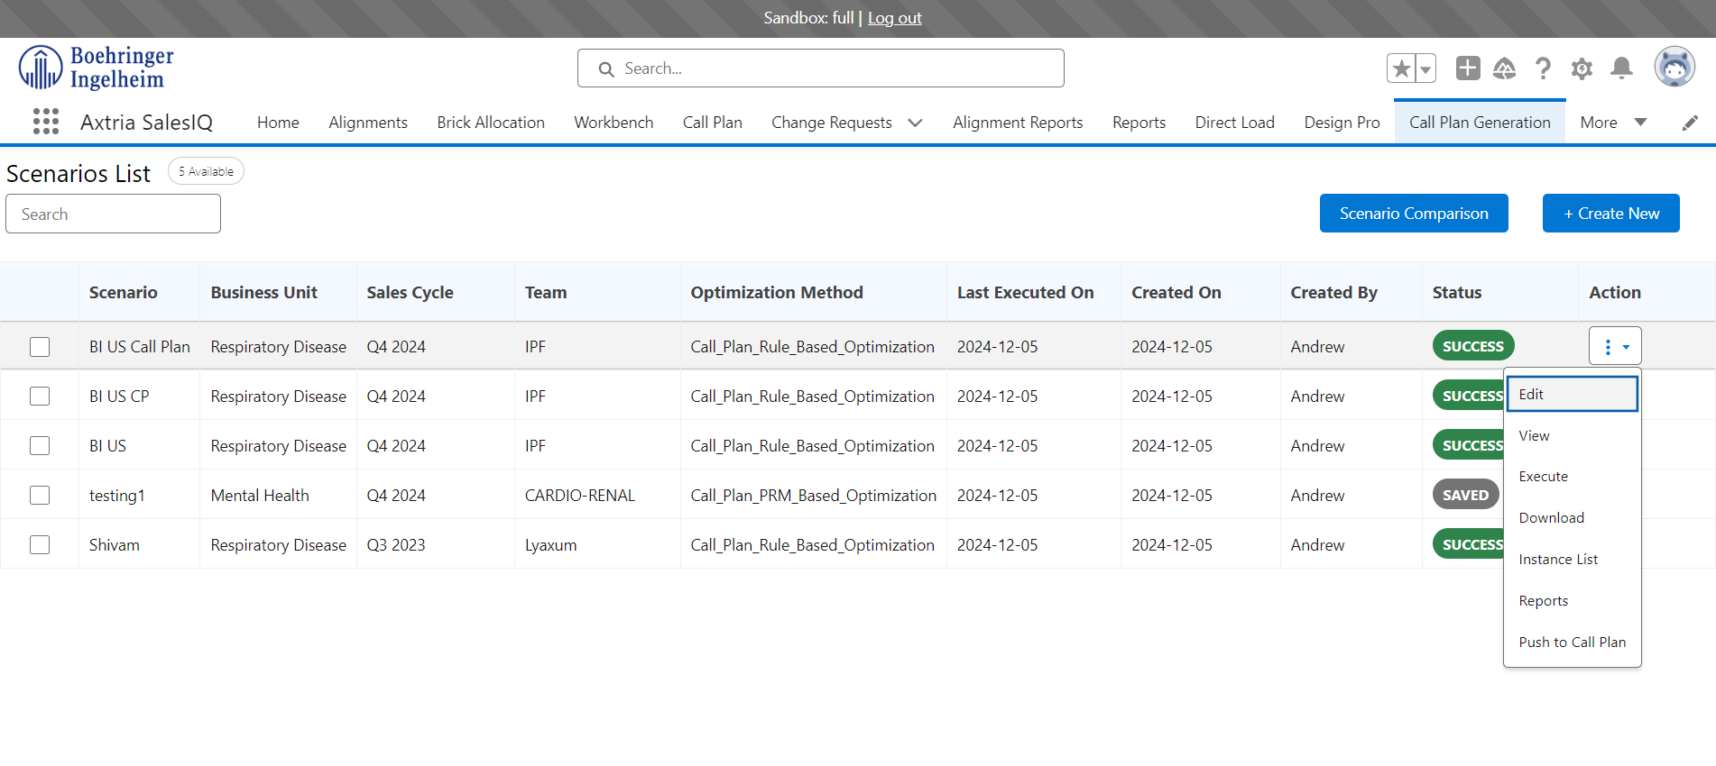
Call Plan Generation – Action
View action item on executed call plan.
Able to edit the business rules of the current scenario.
Able to view the business rules of the current scenario.
Able to execute the scenario.
Able to download the call plan.
Able to view the diagnostic reports

Slide 4
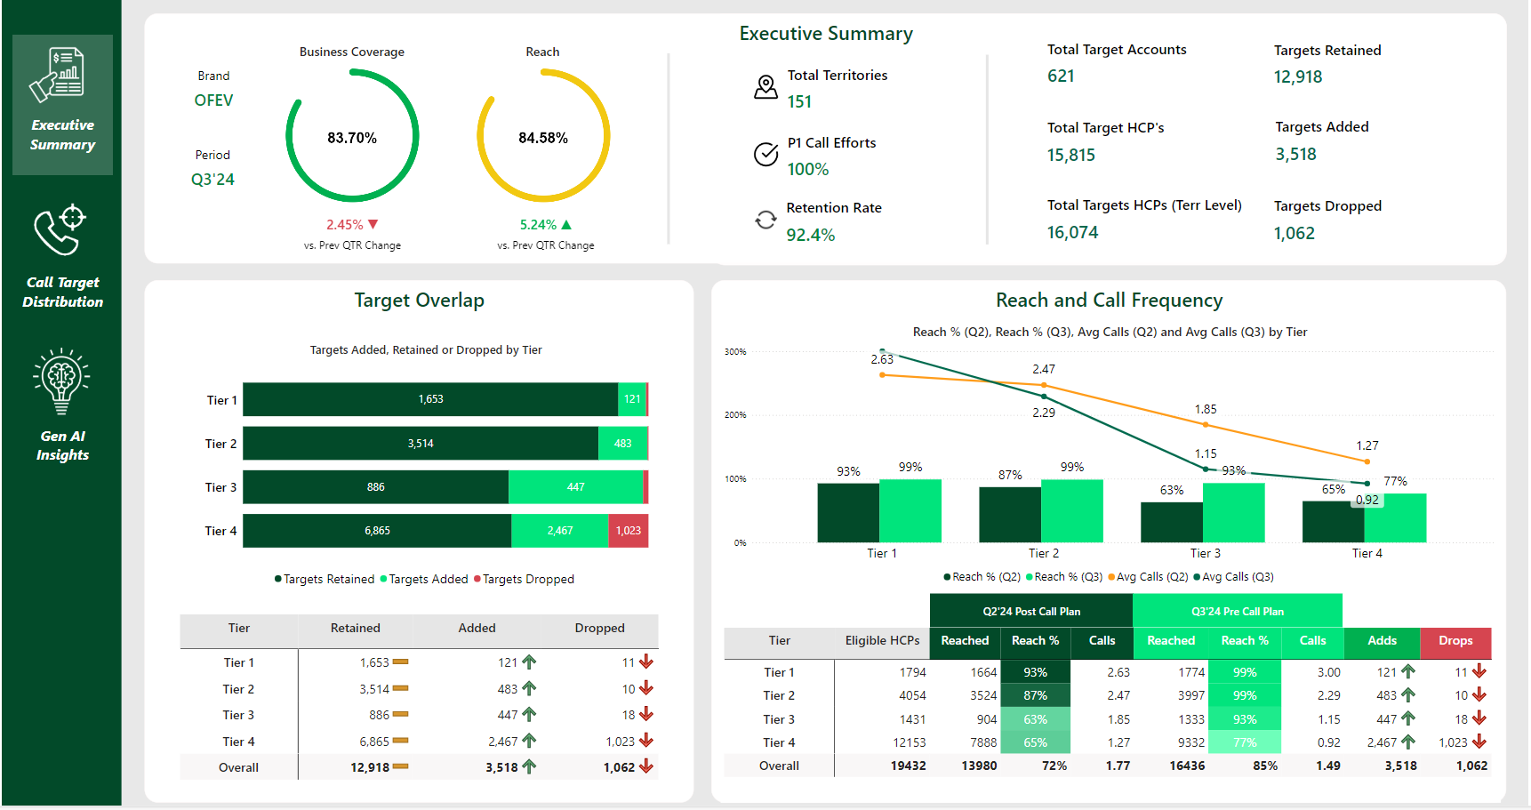
Call Plan Generation – Pre-Refinement Diagnostic
Axtria | N/A
Boehringer | Home Office Users
View call plan diagnostics reports.
Able to view the KPI configured :
Executive Summary
Target overlap with the previous call plan
Reach and frequency comparison

